Slide 1
Software Engineering
Capstone Project

Slide 2
Capstone Project
You are required to define, design and deliver a software project towards the end of the course, showcasing the skills you have learnt in the course. It will give you full exposure to the software development life cycle.
Project deliverables:
Code (GitHub repository including a Readme file)
Presentation and Demo of 5-10 minutes
Project document (template provided)
Please have regular check-ins with your lead trainer to maximise chances of a successful outcome

Slide 3
Scope
Your project must make use of the following:
Client-Server architecture (or Client - Server - other services)
A database for CRUD operations
Displaying data and updating it
A user interface to submit new data
Unit testing
Examples include user management systems, an online store, or implementing a popular board game

Slide 4
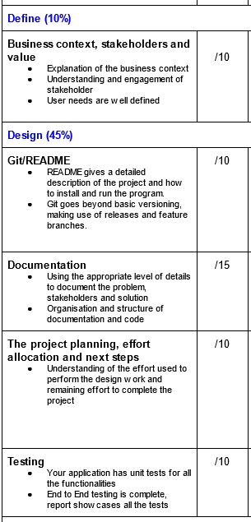
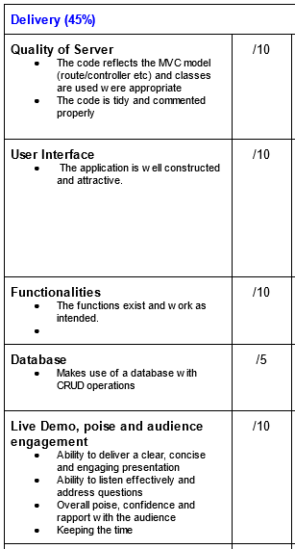
Project evaluation criteria
The project is evaluated on the quality, clarity and completeness of its definition, design and delivery.

